Slide 1

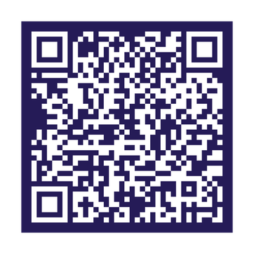
SafeOp Project
Scan for
full recommendations
Notes:
Slide 1 — SafeOp Project
SAFEOp is a Health Canada-funded, University of Toronto-affiliated initiative that brings together updated consensus guidance, education, and implementation resources to support responsible pain management prescribing and help prevent opioid-related harms.

Slide 2
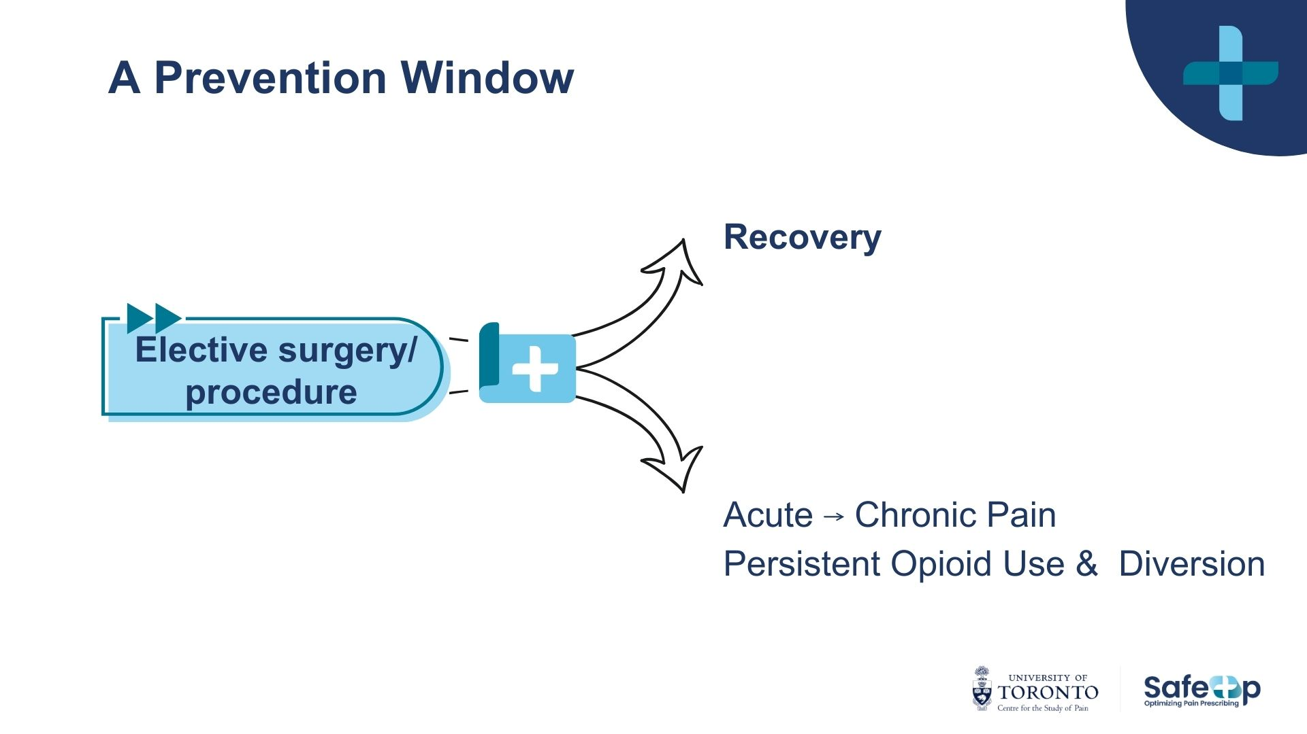
Notes:
The prevention opportunity is significant. High-quality pain care after surgery can support recovery, reduce the risk of acute pain becoming chronic, and prevent opioid-related harms through individualized prescribing, shared safety planning, safe storage and disposal, and clear follow-up when pain, function, or medication needs change.

Slide 3





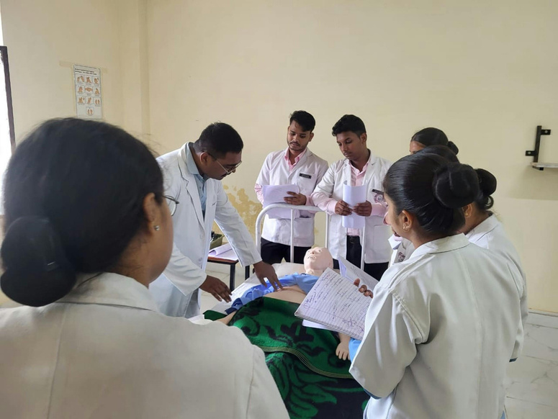

Post- Surgical Pain: Emerging Guidance
5 domains of responsible post-surgical pain care
Risk Assessment
Prescribing practices
Follow-up
Patient education
Policies & Training
Notes:
This consensus statement focuses on post-surgical acute pain in opioid-naïve adults. The goal is not just to share guidance, but to leave you with practical ways to apply responsible pain management prescribing in your own setting.
If you take one thing from this slide, it is this: responsible prescribing is not about prescribing less at all costs. It is about prescribing thoughtfully, with the right supports, for the right patient, at the right time.
The recommendations fall into five practical buckets.
First: identify safety and support needs early.
Patients do not all enter surgery with the same pain history, recovery context, or support system. Screen early for factors that may shape recovery, including chronic pain, mental health, substance use, prior pain experiences, and social supports. Where needs are more complex, flag them early and involve pain expertise where available.
Second: build a multimodal foundation.
Use acetaminophen, NSAIDs where appropriate, physical strategies, education, and non-drug supports as the foundation of acute pain care. Opioids should not be the foundation of the plan, but they may be an appropriate tool when pain is moderate to severe or when function and recovery are at risk.
when opioids are needed, prescribe with precision.
Use short-acting opioids, at the lowest effective dose, for the shortest appropriate duration. Match the quantity to the expected recovery trajectory, using tablet ranges as practical prescribing anchors — not one-size-fits-all rules. The goal is to support comfort, function, recovery, and safety while accounting for pain severity, prior pain history, and the person’s support needs.
Third: plan for reassessment and continuity.
Every opioid prescription should come with a clear follow-up plan. If pain or function is not improving as expected, that should trigger reassessment, support, and escalation where needed — not automatic refills, abrupt discontinuation, or patients being left without a plan.
And fourth: make patient education part of the prescription.
Patients need clear, practical guidance on what to expect, how to use medication safely, when and how to taper, how to store and dispose of opioids, and who to contact if pain is not controlled. Education is not an add-on — it is harm prevention.
Sixth: support practice change through policy and training.
Make responsible prescribing easier to do consistently. That means embedding the guidance into local policies, order sets, discharge workflows, and team training — so safe, patient-centred acute pain care becomes standard practice, not individual variation.

Slide 4
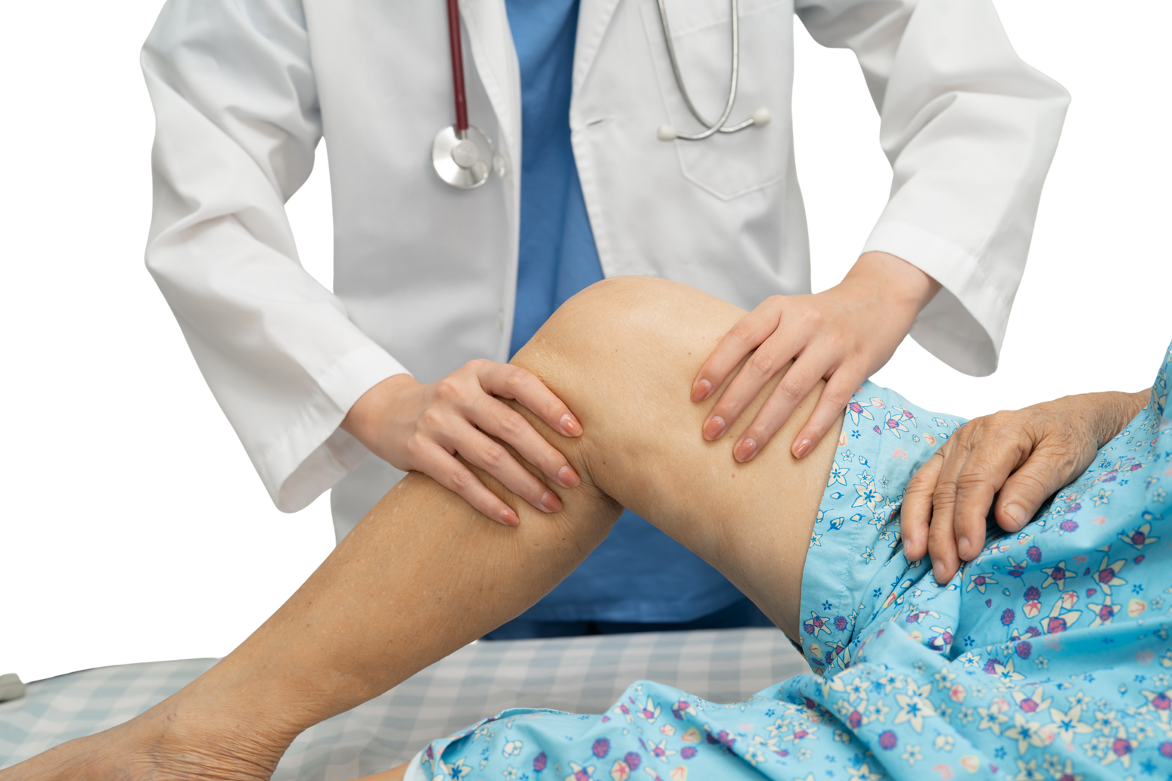
Case: What would you prescribe at discharge?
65-year-old patient
Total knee arthroplasty
Moderate opioid use in hospital
Expected recovery >4 weeks
Notes:
Now that we’ve walked through the consensus recommendations, let’s apply them to a case.
Here, we have a 65-year-old patient undergoing total knee arthroplasty. They required opioids in hospital, and their expected recovery is longer than four weeks.
So the question becomes: what does responsible discharge prescribing look like in this context?
Let’s walk through it using the framework — but adapting the plan to the procedure, the recovery trajectory, and the patient’s needs.

Slide 5
Applying the recommendations
  Risk
    Higher pain burden (procedure + age)
    No misuse risk identified → standard plan
  Multimodal
    Acetaminophen + NSAIDs (scheduled)
    Non-drug strategies
    Opioids as needed, breakthrough pain
      Short-acting, lowest effective dose
      0-60 tablets--> long expected recovery
      Partial fill
  Follow-up
    Reassess pain + function
    No automatic refills
  Education
    Pain is expected
    Function over zero pain
    When to seek help
65-year-old patient
Total knee arthroplasty
Moderate opioid use in hospital
Expected recovery >4 weeks
Notes:
First: consider the recovery context.
This procedure has a higher pain burden and longer recovery. With no additional safety or support needs identified, we proceed with a structured plan and clear follow-up.
Second: keep multimodal care as the foundation.
Use scheduled acetaminophen, NSAIDs where appropriate, and non-drug strategies to support comfort and recovery.
Third: use opioids carefully when needed.
Short-acting opioids may be appropriate for breakthrough pain, at the lowest effective dose and shortest appropriate duration. For this recovery category, up to 60 tablets is a ceiling, not a target. A part-fill can help match supply to actual need.
Fourth: plan reassessment and continuity.
Renewals should be based on reassessment of pain, function, side effects, and recovery progress. If recovery is not progressing as expected, that should prompt care adjustment, additional support, or referral.
Fifth: educate and support the patient.
Set expectations for a longer recovery, provide a tapering plan, review safe use, storage, and disposal, and make sure they know who to contact.
The same principles apply, but the plan is adapted to the person, the procedure, and the expected recovery trajectory.

Slide 6
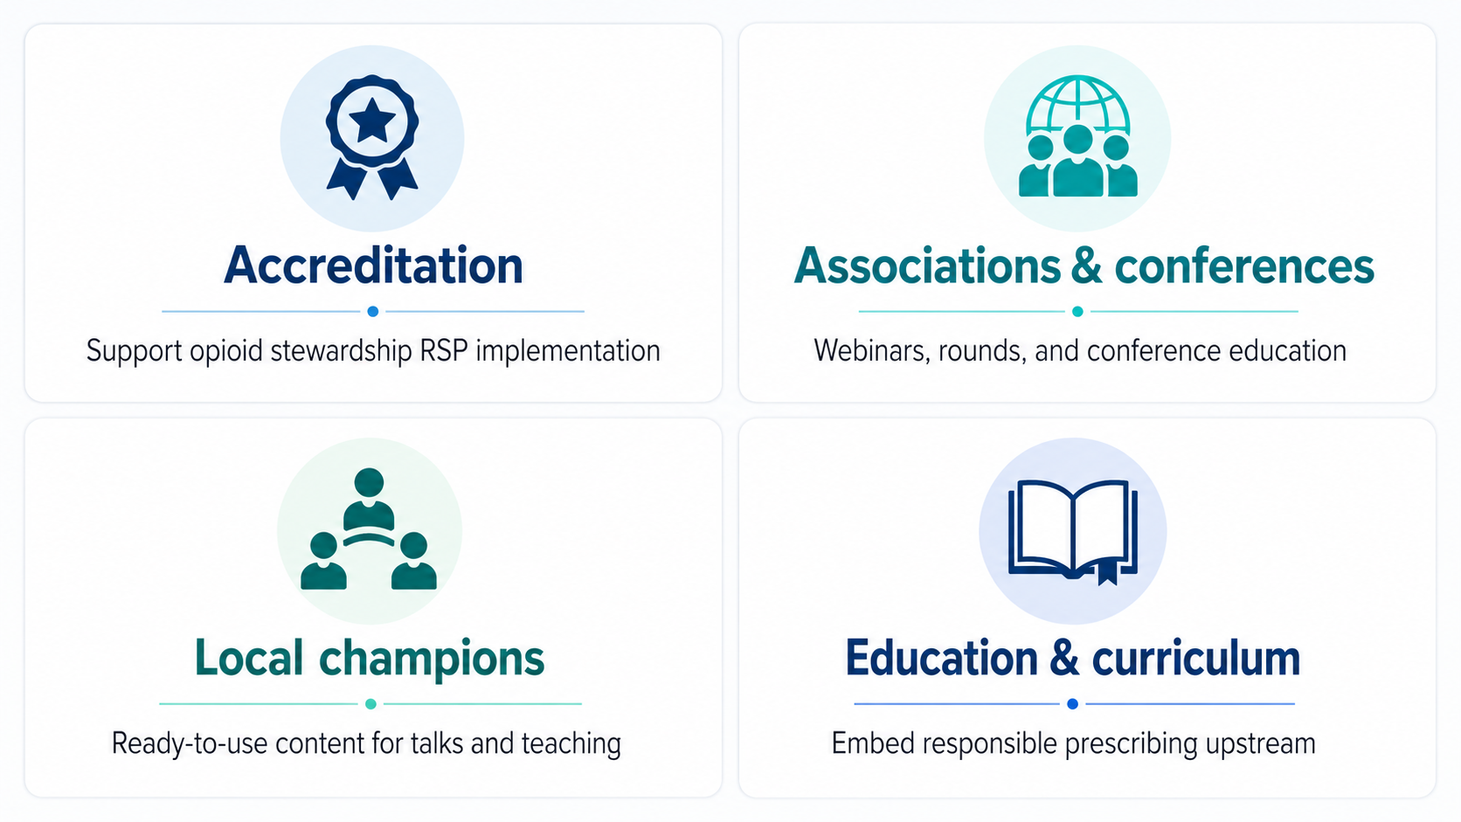
SafeOp KT Strategy
Notes:
This case shows how the recommendations can be adapted to the procedure, recovery trajectory, and patient needs.
The next step is making that approach easier to use consistently across settings. The KT plan focuses on four pathways: accreditation support, professional associations and conferences, local champions, and education.

Slide 7
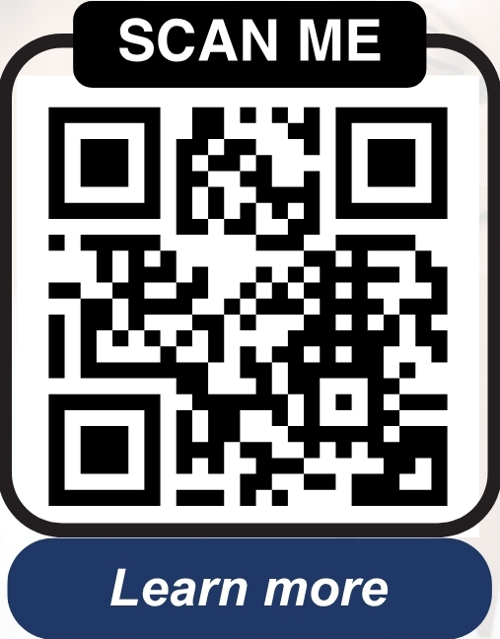
From Consensus to Impact
Use these recommendations to:
Strengthen discharge prescribing practices
Embed consistent patient education into perioperative care
Support team-based implementation through local workflows, policies, and training
Connect with us
Email: utcsp@utoronto.ca
Website: https://www.safeop.ca/
This project was funded by Health Canada
Notes:
The call to action is to use these recommendations in your own practice, and to identify where SAFEOp resources could support broader uptake in your setting — whether through accreditation, teaching, talks, rounds, or curriculum. If you see an opportunity, connect with the SAFEOp team.

Slide 8

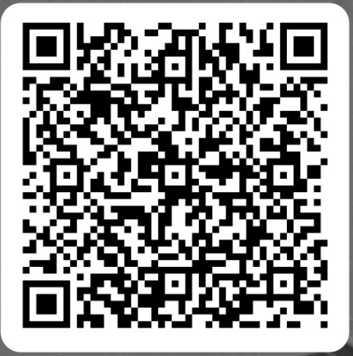

Please scan
Your feedback will help refine resources and support evidence-informed perioperative pain management.
Notes:
Before we move on, please take a quick moment to scan the QR code.
We are actively refining these SafeOp resources for real conference, hospital, and teaching settings.
Your feedback helps us understand what is useful, what is unclear, and what would make this easier to apply.

Slide 9
Thank You
For Your Attention

