Slide 1


SafeOp Project
Scan for
full recommendations
Notes:
SAFEOp is a Health Canada-funded, University of Toronto-affiliated initiative that brings together updated consensus guidance, education, and implementation resources to support responsible pain management prescribing and help prevent opioid-related harms.

Slide 2
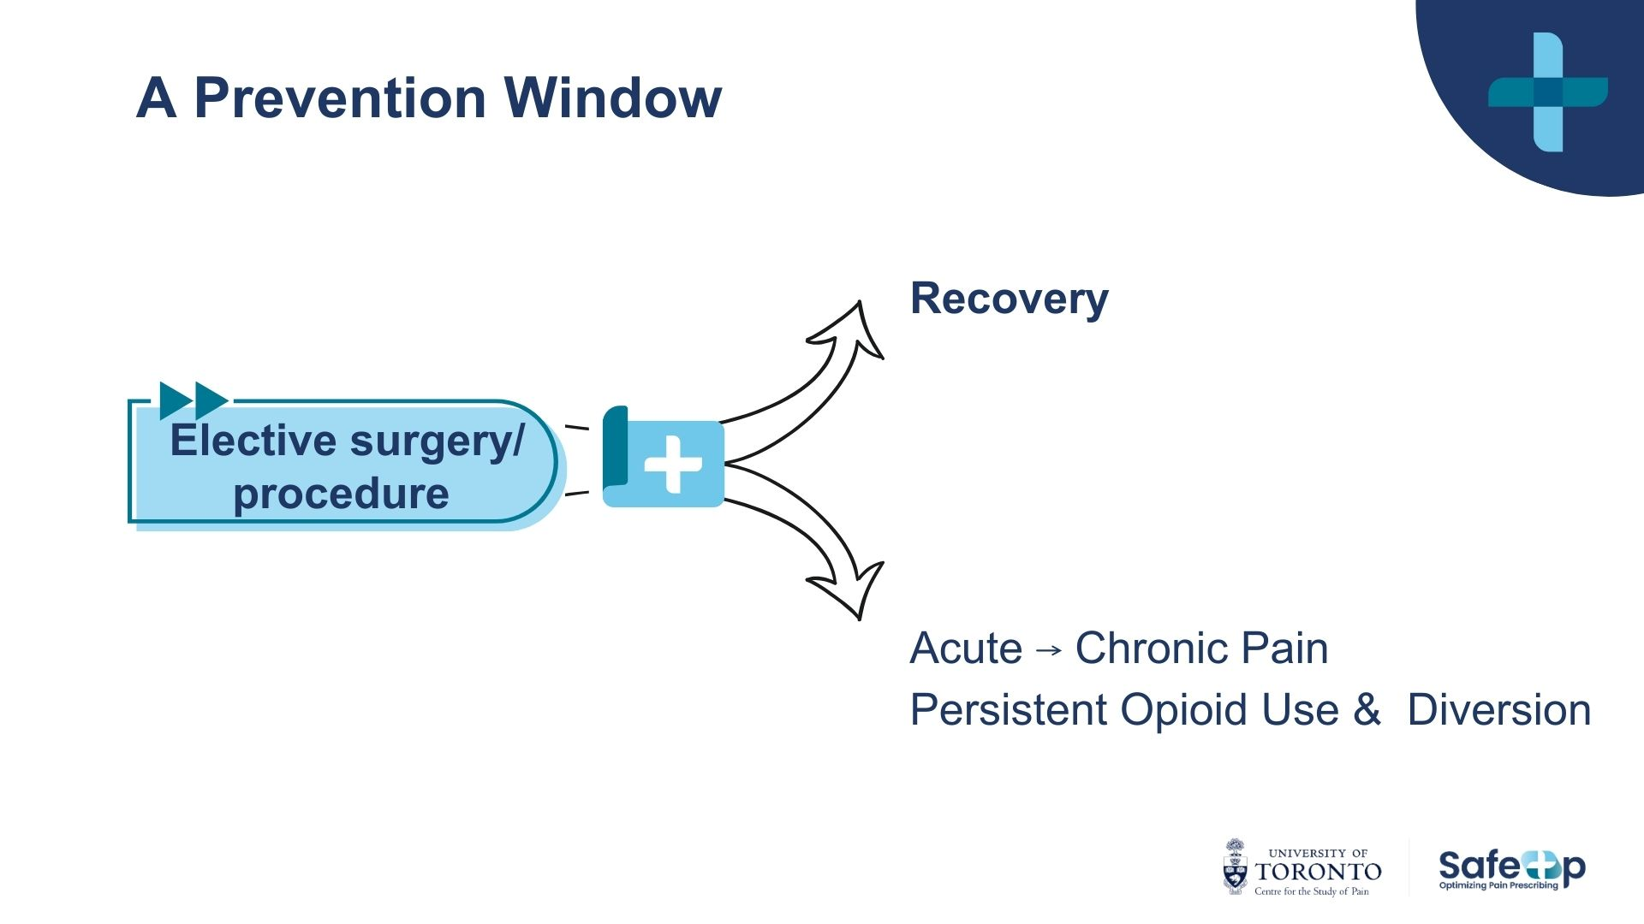
Notes:
The prevention opportunity is significant. High-quality pain care after surgery can support recovery, reduce the risk of acute pain becoming chronic, and prevent opioid-related harms through individualized prescribing, shared safety planning, safe storage and disposal, and clear follow-up when pain, function, or medication needs change.

Slide 3







Post- Surgical Pain: Emerging Guidance
5 domains of responsible post-surgical pain care
Risk Assessment
Prescribing practices
Follow-up
Patient education
Policies & Training
Notes:
This consensus statement focuses on post-surgical acute pain in opioid-naïve adults. The goal is not just to share guidance, but to leave you with practical ways to apply responsible pain management prescribing in your own setting.
If you take one thing from this slide, it is this: responsible prescribing is not about prescribing less at all costs. It is about prescribing thoughtfully, with the right supports, for the right patient, at the right time.
The recommendations fall into five practical buckets.
First: identify safety and support needs early.
Patients do not all enter surgery with the same pain history, recovery context, or support system. Screen early for factors that may shape recovery, including chronic pain, mental health, substance use, prior pain experiences, and social supports. Where needs are more complex, flag them early and involve pain expertise where available.
Second: build a multimodal foundation.
Use acetaminophen, NSAIDs where appropriate, physical strategies, education, and non-drug supports as the foundation of acute pain care. Opioids should not be the foundation of the plan, but they may be an appropriate tool when pain is moderate to severe or when function and recovery are at risk.
when opioids are needed, prescribe with precision.
Use short-acting opioids, at the lowest effective dose, for the shortest appropriate duration. Match the quantity to the expected recovery trajectory, using tablet ranges as practical prescribing anchors — not one-size-fits-all rules. The goal is to support comfort, function, recovery, and safety while accounting for pain severity, prior pain history, and the person’s support needs.
Third: plan for reassessment and continuity.
Every opioid prescription should come with a clear follow-up plan. If pain or function is not improving as expected, that should trigger reassessment, support, and escalation where needed — not automatic refills, abrupt discontinuation, or patients being left without a plan.
And fourth: make patient education part of the prescription.
Patients need clear, practical guidance on what to expect, how to use medication safely, when and how to taper, how to store and dispose of opioids, and who to contact if pain is not controlled. Education is not an add-on — it is harm prevention.
Sixth: support practice change through policy and training.
Make responsible prescribing easier to do consistently. That means embedding the guidance into local policies, order sets, discharge workflows, and team training — so safe, patient-centred acute pain care becomes standard practice, not individual variation.

Slide 4



“Hi, I’m Louisa, I can’t wait to go back home”
CASE NOTES
Louisa is 42, opioid-naïve, and having a laparoscopic hysterectomy with moderate recovery expected
Meet Our Patient
What would you normally plan to prescribe at discharge?
Notes:
Meet Louisa / Initial Prescribing Decision
Say
Now that we’ve walked through the consensus recommendations, let’s apply them to a case.
Louisa is 42, opioid-naïve, and having a laparoscopic hysterectomy with moderate recovery expected.
Before we know anything else, pause and notice what you would normally prescribe at discharge.
This case starts with habit on purpose — many discharge prescriptions are shaped by routine, procedure type, or local norms.
Ask
What would you normally plan to prescribe at discharge?
Land
There is no single “normal” postoperative prescription.
Discharge prescribing should be informed by more than the procedure.
Key factors include pre-op risk, perioperative pain management, inpatient opioid use, and anticipated recovery.
Extra — scientific evidence
Postoperative opioid prescribing varies widely, even for similar procedures. (Chen et al., 2018)
Procedure type alone does not capture patient-specific risk or recovery needs. (Brat et al., 2018; Sun et al., 2016)
Inpatient opioid use before discharge can help guide discharge quantity. (Chen et al., 2018; Hill et al., 2017)
Patients who use no opioids before discharge may still receive opioids, suggesting overprescribing. (Chen et al., 2018)
Postoperative prescriptions are not always tailored to patient risk factors such as age. (Ladha et al., 2020)

Slide 5


Pause Before Prescribing
Pre-operatively, Louisa said she has significant anxiety.
What changes in the plan — and what stays the same?
“I am very anxious about the pain”
Transitional pain service
Notes:
Pause Before Prescribing / Risk Changes Planning
Say
Louisa disclosed significant preoperative anxiety, which may increase her risk for higher pain needs, prolonged pain, and persistent opioid use.
This does not mean less pain treatment. It means more deliberate planning.
For Louisa, that could mean: pre-op pain consultation if available, a tailored opioid-sparing plan, clear education and coping strategies, attention to inpatient opioid use, and planned follow-up after discharge.
Ask
What changes in the plan — and what stays the same?
Land
Risk changes planning, not access.
Higher risk should trigger more structure, not less care.
The practical response is: plan earlier, educate clearly, reassess before discharge, prescribe based on actual need, and arrange follow-up.
Extra — scientific evidence
Preoperative anxiety is associated with higher postoperative analgesic requirements. (Shebl et al., 2025)
Higher preoperative anxiety is associated with increased risk of chronic postsurgical pain at 3+ months. (Bakker-Bons et al., 2025; Theunissen et al., 2012)
In opioid-naïve adults, anxiety is associated with increased odds of new persistent opioid use after surgery. (Brummett et al., 2017; Gong et al., 2024; Lee et al., 2026)
Anxiety should be treated as a risk marker that prompts planning, education, reassessment, and follow-up — not as a reason to withhold pain treatment. (Bakker-Bons et al., 2025; Chou et al., 2016)

Slide 6

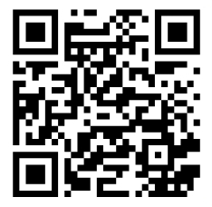
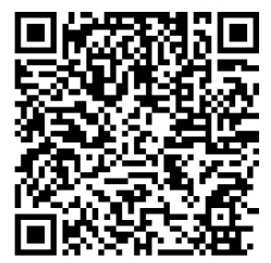
Education begins before surgery
Function and recovery, not zero pain
  Acetaminophen & NSAIDs
  mobility
  non-pharmacologic strategies
  opioids for breakthrough only
When? Who? What?
Pain after surgery
course
Power over Pain Portal
“It helps to know some pain is ok”
Notes:
Education Begins Before Surgery / Function and Recovery
Say
Preoperative education matters because it shapes expectations before discharge.
The goal after surgery is usually not zero pain. The goal is pain controlled enough to support recovery.
The QR codes connect patients and providers to resources that can support this education before and after surgery.
Ask
In your setting, when does this education happen — and who delivers it?
Land
Some pain is expected.
Function matters more than a pain score alone.
Opioids are not the centre of recovery.
Education needs a clear when, who, and what.
Extra — scientific evidence
Preoperative education can reduce anxiety and improve preparedness for recovery. (Lee et al., 2018; Ronco et al., 2012)
Setting expectations can reduce distress when expected postoperative pain occurs. (Chou et al., 2016; Lee et al., 2018)
Multimodal analgesia reduces reliance on opioids by combining non-opioid medications and non-pharmacologic strategies. (Chou et al., 2016; Wick et al., 2017)
Functional recovery is often more meaningful than pain intensity alone. (Chou et al., 2016; Myles et al., 2016)
Education should include safe opioid use, tapering, storage, and disposal. (Bicket et al., 2017; Clarke et al., 2020)

Slide 7

IF Opioids are required,
30 IS A CEILING, not a target
Quantity depends on
  inpatient opioid use
  anticipated recovery
  functional needs
  breakthrough pain only
Avoid
  codeine
  combination products
  long-acting opioids
Prescribing principles
  time-limited
  written at discharge
Preferred
  short-acting
  lowest effective dose
“I needed less meds than I thought!”
What would justify escalating quantity?
Notes:
0–30 Tablets Is a Ceiling, Not a Standard
Say
This slide reframes opioid quantity guidance: 30 tablets may be an upper limit for some moderate recovery procedures, but it is not the default.
Quantity should be based on actual clinical information: inpatient opioid use, anticipated recovery, functional needs, and breakthrough pain.
If opioids are needed, use short-acting opioids at the lowest effective dose, for the shortest duration.
Ask
What information would justify prescribing closer to the ceiling?
Land
Upper limit does not mean default.
Prescribing should follow the anticipated recovery trajectory.
Uncertainty and unclear follow-up often drive overprescribing.
Opioid prescriptions should be written at discharge, when actual need is clearer.
Extra — scientific evidence
Many patients use fewer opioids than prescribed after surgery, leaving unused tablets in the home. (Bicket et al., 2017; Schirle et al., 2020)
Unused opioids increase risk for diversion, misuse, and accidental exposure when not stored or disposed of safely. (Bicket et al., 2017; Schirle et al., 2020)
Procedure-specific prescribing guidance can reduce opioid prescribing without worsening pain or satisfaction. (Howard et al., 2018; Michigan OPEN, 2025)
Larger initial opioid prescriptions are associated with greater opioid consumption after surgery. (Howard et al., 2019)
Longer initial opioid exposure is associated with higher risk of persistent use or misuse among opioid-naïve patients. (Brat et al., 2018; Sun et al., 2016)
Inpatient opioid use before discharge can help estimate post-discharge opioid need. (Hill et al., 2017; Thiels et al., 2018)
Codeine has variable metabolism and less predictable analgesic and safety effects. (Crews et al., 2014)
Immediate-release opioids are preferred for acute pain; extended-release/long-acting opioids should generally be avoided. (Centers for Disease Control and Prevention [CDC], 2022)
Combination opioid–acetaminophen products can make acetaminophen exposure harder to track. (Health Canada, 2018, 2025)

Slide 8


Not Feeling Better
Reassess
  pain
  function
  recovery trajectory
Rule out
  complications
  worsening condition
  Concerns re opioid-related harms
Refer
  persistent pain
  functional decline
  concern for harm
“I thought I’d be feeling better by now”
What Now?
Notes:
Not Feeling Better / Reassess, Rule Out, Refer
Say
Recovery does not always progress as expected.
Persistent pain should trigger reassessment, not an automatic refill.
Reassess pain, function, opioid use, and recovery trajectory; rule out complications; refer when needed.
Ask
Who reassesses this patient in your setting?
Land
Reassessment interrupts reflexive prescribing.
Function matters as much as pain score.
Some situations require escalation of care, not escalation of opioids.
Monitoring matters after discharge.
Extra — scientific evidence
Poorly controlled acute postoperative pain can increase risk for chronic postsurgical pain and functional impairment. (Chou et al., 2016; Katz & Seltzer, 2009)
New persistent opioid use occurs in opioid-naïve surgical patients and is linked to patient, surgical, and prescribing factors. (Brat et al., 2018; Gong et al., 2024; Sun et al., 2016)
Larger postoperative opioid prescriptions are associated with higher odds of new persistent opioid use. (Brummett et al., 2022)
Higher-intensity postoperative prescribing may increase refill risk and is a quality-improvement target. (Wunsch et al., 2023)
Postoperative pain care should be individualized and multimodal, with reassessment of pain, function, and safety. (Chou et al., 2016)

Slide 9

Follow-up is part of prescribing
  clear expectations
  tapering guidance
  contact information
  reassessment
  no refills without reassessment
  continuity of care
“The follow-up mattered more than the prescription.”
Who reassesses? What next?
Notes:
Not Feeling Better / Reassess, Rule Out, Refer
Say
Recovery does not always progress as expected.
Persistent pain should trigger reassessment, not an automatic refill.
Reassess pain, function, opioid use, and recovery trajectory; rule out complications; refer when needed.
Ask
Who reassesses this patient in your setting?
Land
Reassessment interrupts reflexive prescribing.
Function matters as much as pain score.
Some situations require escalation of care, not escalation of opioids.
Monitoring matters after discharge.
Extra — scientific evidence
Poor acute postoperative pain can increase risk for chronic postsurgical pain. (Chou et al., 2016; Katz & Seltzer, 2009)
New persistent opioid use occurs in opioid-naïve surgical patients. (Brat et al., 2018; Sun et al., 2016)
Larger postoperative prescriptions are associated with higher odds of persistent opioid use. (Howard et al., 2023)
High-intensity prescribing is associated with persistent opioid use and may be a QI target. (Wunsch et al., 2023)
Postoperative pain care should be individualized, multimodal, and reassessed over time. (Chou et al., 2016)

Slide 10

Patients’ Experiences Evolve.
  recovery trajectory
  inpatient opioid use
  anxiety/risk factors
  functional recovery
  reassessment findings
“My care evolved as my recovery evolved”
Prescribe responsively: recovery + risk + function + reassessment
Notes:
Experiences Evolve / Reflective Synthesis
Say
This slide is about clinical reasoning, not memorizing rules.
As Louisa’s recovery evolves, prescribing decisions should evolve too.
Prescribing should reflect recovery trajectory, inpatient opioid use, anxiety/risk factors, function, and reassessment findings.
Ask
What is one part of this framework that may influence your own postoperative prescribing practice?
Land
The goal is not simply fewer opioids.
The goal is responsive prescribing.
Safe postoperative prescribing requires flexibility and reassessment.
Better prescribing means the right plan, amount, education, and follow-up.
Extra — scientific evidence
Postoperative prescribing should be individualized and multimodal, with ongoing reassessment. (Chou et al., 2016)
Inpatient opioid use helps estimate post-discharge opioid need. (Hill et al., 2017; Thiels et al., 2018)
Higher opioid exposure after surgery is associated with greater risk of persistent opioid use. (Brat et al., 2018; Sun et al., 2016)
Preoperative anxiety is a risk factor for more complex postoperative pain and opioid-use trajectories. (Hinrichs-Rocker et al., 2009; Theunissen et al., 2012)
Procedure-specific prescribing guidance can reduce excess opioid prescribing without worsening pain outcomes. (Howard et al., 2018; Zhang et al., 2020)

Slide 11
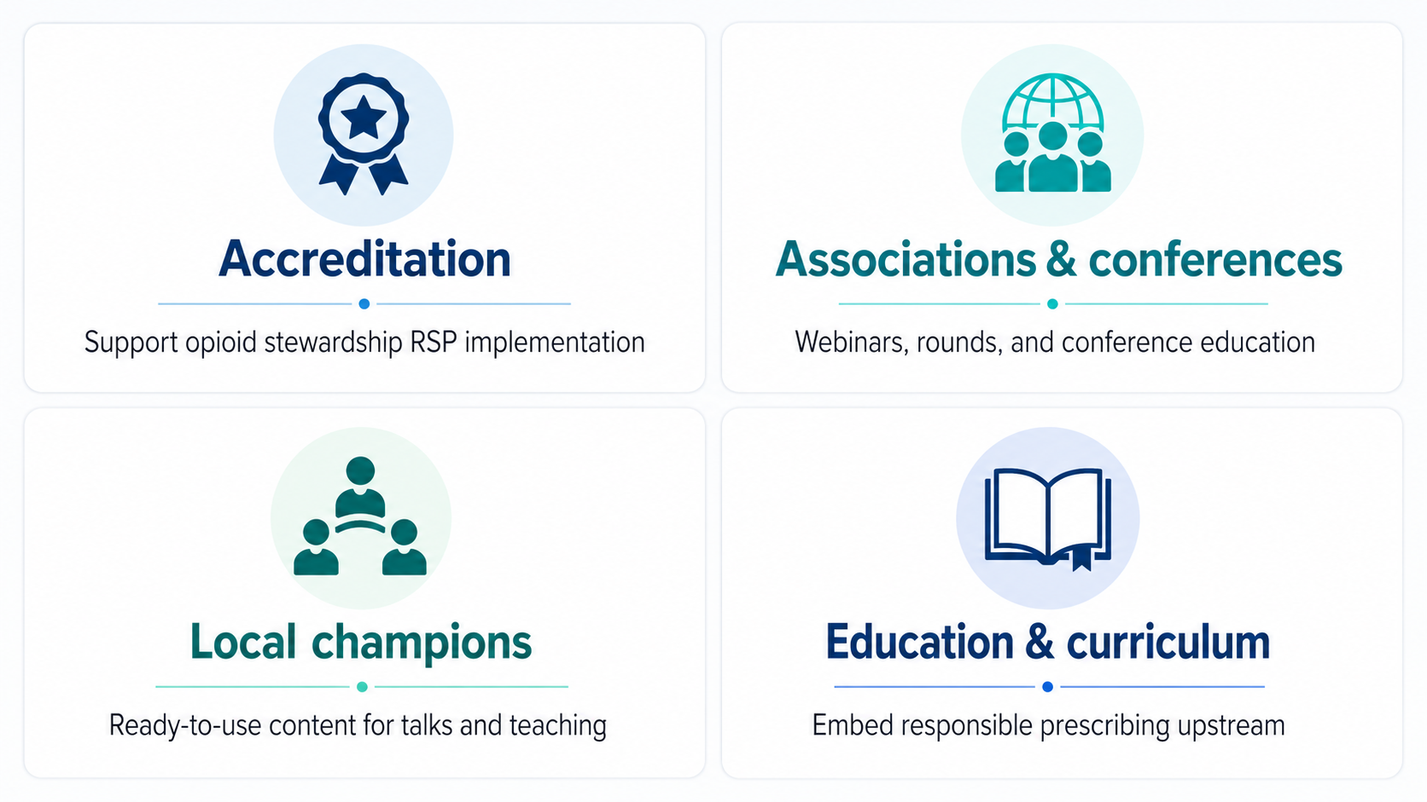
SafeOp KT Strategy
Notes:
This case shows how the recommendations can be adapted to the procedure, recovery trajectory, and patient needs.
The next step is making that approach easier to use consistently across settings. The KT plan focuses on four pathways: accreditation support, professional associations and conferences, local champions, and education.

Slide 12

From Consensus to Impact
We invite clinicians, organizations, and health systems to:
Integrate these recommendations into discharge prescribing practices
Standardize patient education materials
Connect with us
Email: utcsp@utoronto.ca
Website: https://www.safeop.ca/
This project was funded by Health Canada
Notes:
The call to action is to use these recommendations in your own practice, and to identify where SAFEOp resources could support broader uptake in your setting — whether through accreditation, teaching, talks, rounds, or curriculum. If you see an opportunity, connect with the SAFEOp team.

Slide 13

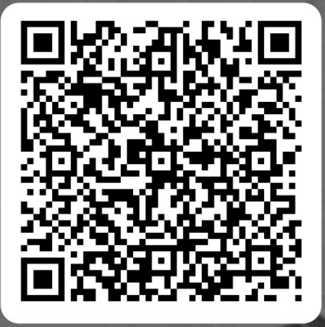

Please scan
Your feedback will help refine resources and support evidence-informed perioperative pain management.
Notes:
Before we move on, please take a quick moment to scan the QR code.
We are actively refining these SafeOp resources for real conference, hospital, and teaching settings.
Your feedback helps us understand what is useful, what is unclear, and what would make this easier to apply.

Slide 14
Thank You
For Your Attention

